Slide 1
Engineering A* for Autonomous Path Planning of Tracked Vehicle
Project Guide
Mr. Shibumon Alampata, Scientist – F
Geographical Information Systems Division,
Centre for Artificial Intelligence and Robotics,
Defence Research and Development Organization.
Presented by
Mullainathan V H - 22R435
Sivatmiga T N - 22R447
Department of Robotics and Automation,
PSG College of Technology.

Slide 2
Permafrost Mapping through Multi-Source Geospatial Modeling
A Case Study on Permafrost Probability Mapping

Slide 3
INTRODUCTION
Context:
Permafrost is ground that remains frozen for ≥2 years
Its thaw destabilizes terrain—risking roads, infrastructure, and mobility
Why It Matters:
High-altitude regions like Ladakh, Sikkim face climate-induced thawing
Unstable ground threatens defence logistics and autonomous vehicles
Study Goal:
Model and map probable permafrost zones using remote sensing and empirical models

Slide 4
CHALLENGES
Problem Statement:
Autonomous tanker vehicles face risks in the Western Himalayas due to hidden or melting permafrost, which makes the ground unstable. Without detailed maps, it’s hard to plan safe routes.
This project creates 30 m resolution maps using satellite data to show where permafrost is likely, helping avoid dangerous areas during navigation.
Motivation:
Defense Needs: Army operates in high-altitude zones like Siachen, DBO, and Tawang where ground instability affects roads and supply routes.
No Detailed Maps: Existing maps are too coarse (1 km) and don’t work well for India.
Public Data Available: Satellites like MODIS and Landsat offer free data.
Autonomous Mobility: Just using slope isn’t enough—permafrost zones need to be included in route planning.
Climate Insight: Permafrost is a warning signal for climate change in sensitive regions.

Slide 5
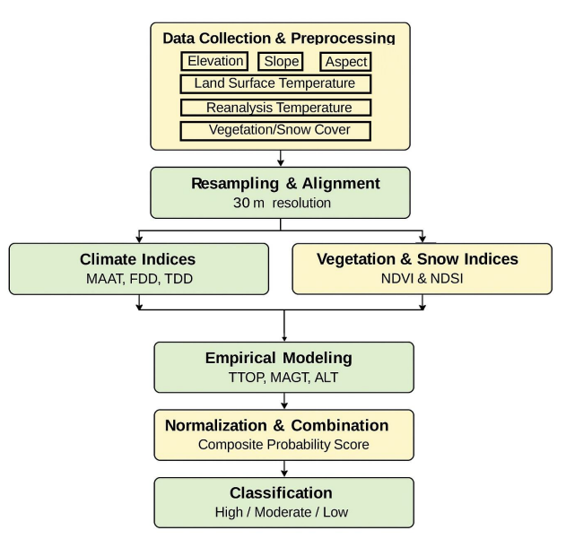
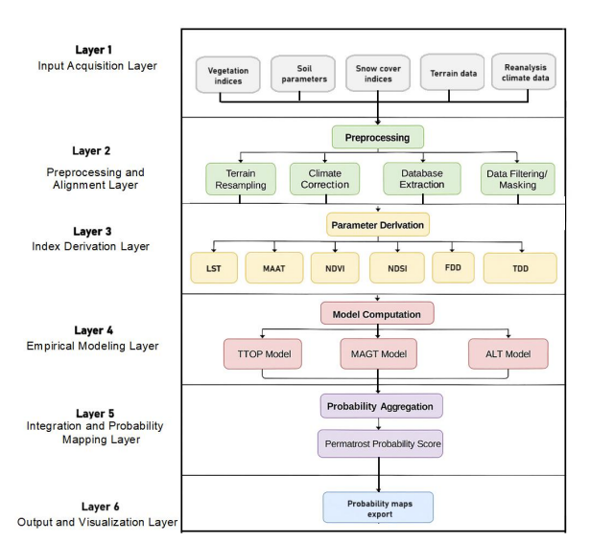
System Architecture and Design

Slide 6
PERMAFROST MAPPING
Region of Interest & Time Period (INDIA):
Coordinates: 75.5°E to 80.5°E, 36.5°N to 28.5°N
Key Locations in India: Leh, Kargil, Diskit, Hunder, Turtuk, Panamik, Sumur, Alchi, Likir, Basgo, Nimoo, Lamayuru, Saspol, Uleytokpo, Rizong
Extended Plains: Chandigarh, Ambala, Ludhiana, Patiala, Amritsar, Shimla, Solan, Dehradun, Meerut, Saharanpur, etc.
Time Period: January 2020 to December 2023
Permafrost Probability Model
Derived a weighted equation from literature (Raza et al., Overduin et al.)
Formula: X = Wm * Rm + Wp * Rp + Wa * Ra + Ws * Rs; PE = X * GSC
Input factors:
MAAT (BMAT from MODIS LST)
Slope & Aspect (from SRTM DEM)
PISR (Potential Solar Radiation)
Ground Surface Cover (NDVI, NDSI)
Normalized ratings and fixed weights (Wm=0.4, Wp=0.2, Wa=0.2, Ws=0.2)
Weights:
Wₘ – Weight for MAAT / BMAT (here, 0.4)
Wₚ – Weight for PISR (0.2)
Wₐ – Weight for Aspect (0.2)
Wₛ – Weight for Slope (0.2)
Ratings (normalized indices or reclassified scores):
Rₘ – Rating based on MAAT (from MODIS LST)
Rₚ – Rating based on PISR (from solar radiation models)
Rₐ – Rating based on aspect (north-facing vs. south-facing)
Rₛ – Rating based on slope steepness
Ground Surface Cover Factor: GSC – Ground Surface Cover coefficient (derived from NDVI, NDSI, land cover classification). It adjusts the combined score to reflect the insulating or exposing effect of vegetation/snow/rock types.
PE: Permafrost Estimation (PE) – Final probabilistic score indicating presence/absence likelihood of permafrost.

Slide 7
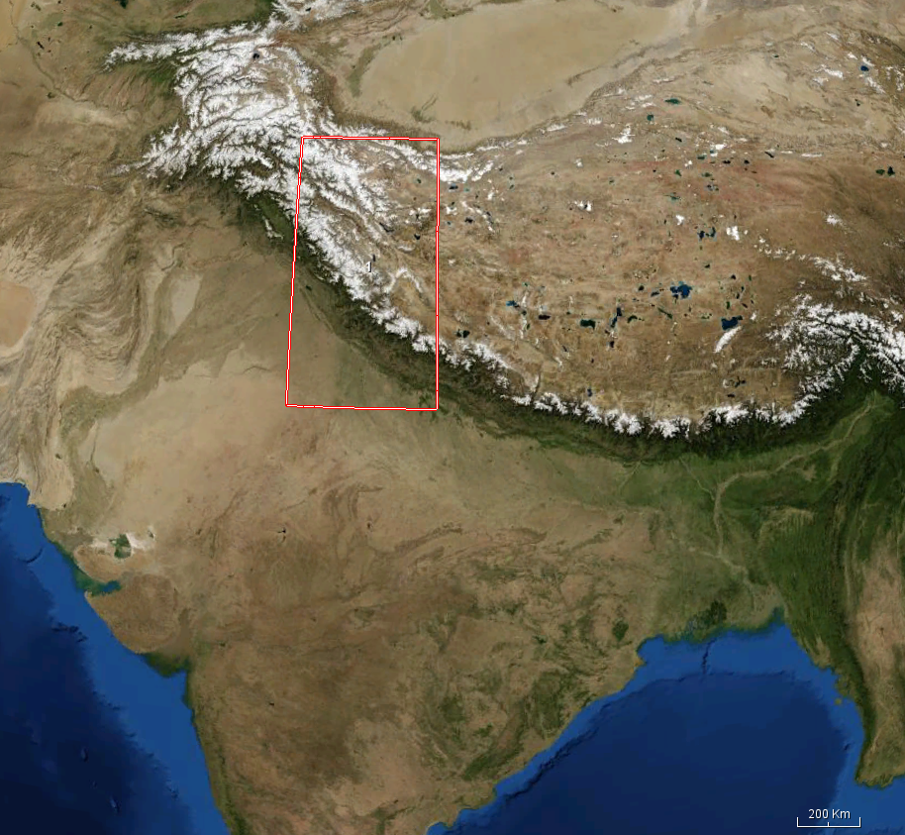
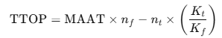
PERMAFROST MAPPING
Step-by-Step Functionality:
1. Load Input Data
Reads raster files: DEM, LST, NDVI, Slope, NDSI, Soil properties, FDD, and TDD.
Resamples them to a common spatial resolution and shape using the DEM as reference.
2. Clean FDD and TDD
Ensures all invalid values (NaN, inf, negative) are handled.
Resizes if shapes don’t match.
3. Estimate Soil Thermal Properties
Computes frozen (Kf) and thawed (Kt) thermal conductivity using clay and bulk density.
Clips them to realistic physical ranges.
4. Estimate n-factors
Surface energy balance correction using NDVI and NDSI:
nf for freezing
nt for thawing
5. Compute TTOP (Temperature at the Top of Permafrost): Where MAAT is approximated from LST.

Slide 8
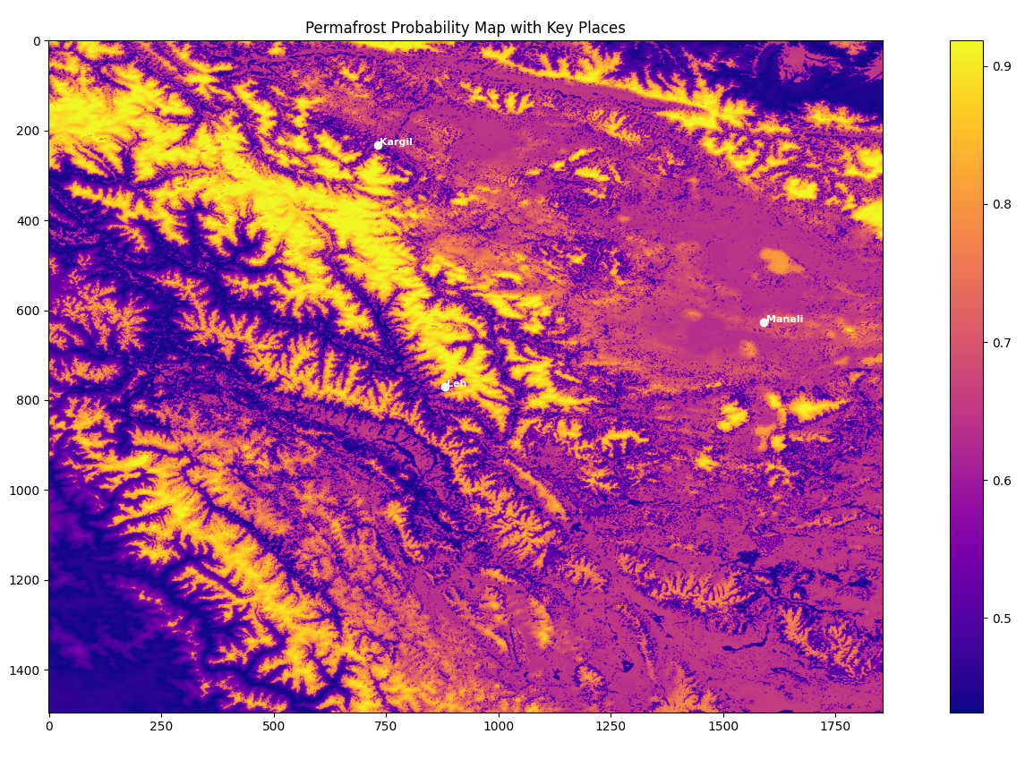
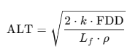
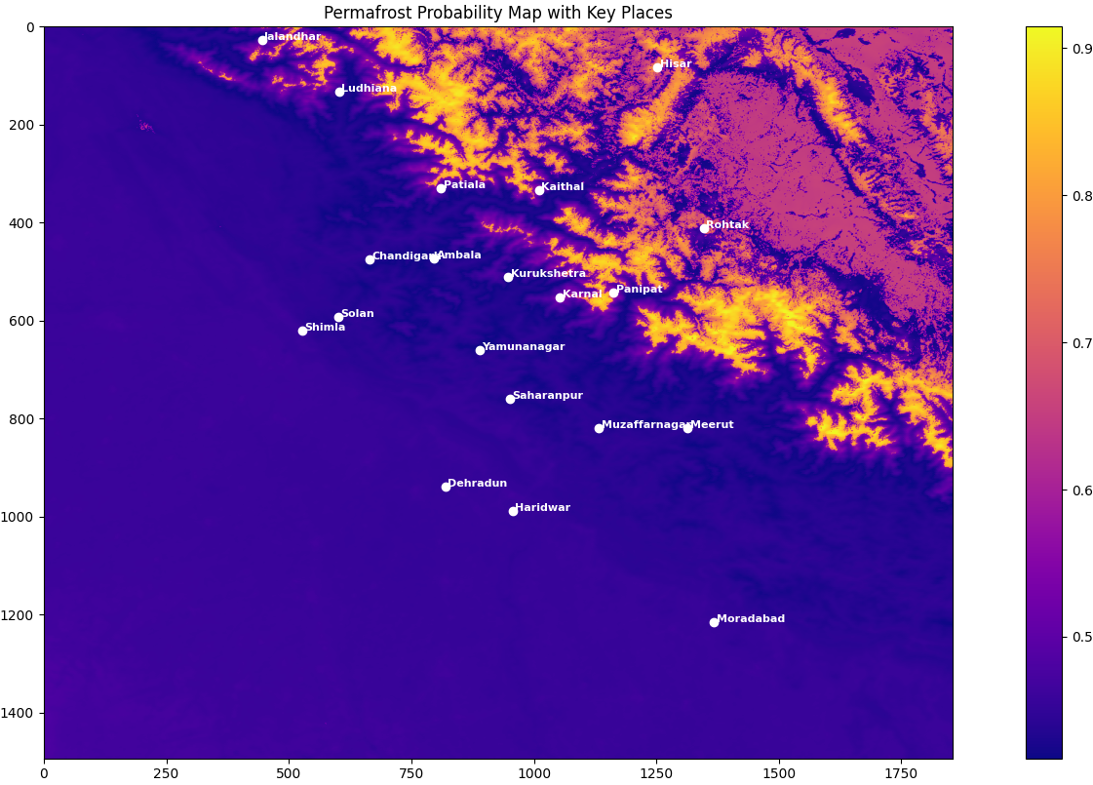
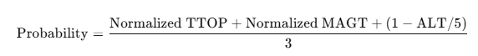
PERMAFROST MAPPING
6. Compute ALT (Active Layer Thickness)
Where:
k = average thermal conductivity
Lf = latent heat of fusion of water
ρ = soil density
7. Classify High Confidence Permafrost Zones: Zones where ALT < 1.5 m are marked as permafrost.
8. Compute Final Permafrost Probability:
9. Export Outputs
ALT.tif: Estimated active layer thickness
Permafrost_Probability.tif: Final combined permafrost probability map
PermafrostZone_ALT_lt_1_5.tif: Binary mask of high-confidence permafrost

Slide 9
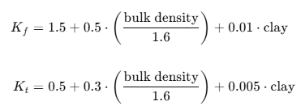
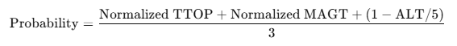
PERMAFROST MAPPING
References:
1. TTOP (Temperature at the Top of Permafrost) Equation
Smith and Riseborough (2002). “Climate and the limits of permafrost: a zonal analysis.” Permafrost and Periglacial Processes.
This equation relates Mean Annual Air Temperature (MAAT), soil thermal conductivities, and n-factors to estimate the ttop.
2. Active Layer Thickness (ALT) Equation
Lunardini (1981). “Heat Transfer in Cold Climates.”
This is based on the Stefan equation, which estimates the depth of seasonal thaw in frozen ground using:
Thermal conductivity k
Freeze Degree Days (FDD)
Soil density ρ
Latent heat of fusion L_f
3. Thermal Conductivity Estimation (Kf, Kt)
Modified from empirical formulations by Zhang et al. (2008) and Riseborough et al. (2008)
These equations approximate frozen and thawed soil conductivity using bulk density and clay content, which are key factors influencing soil thermal behavior.
4. n-Factor Estimation
nf = np.where(NDVI > 0.2, 0.7, 0.5)
nt = np.where(NDSI > 0.3, 0.6, 0.9)
Klene et al. (2001); Zhang et al. (1997)
Empirical assignment of freezing (nf) and thawing (nt) n-factors based on vegetation (NDVI) and snow (NDSI). These affect the surface energy balance.
5. MAGT Proxy Equation
Coefficients used: α = -1.5, β = -2.2, δ = -0.5, ε = -0.2, C = 5.0
Derived from methods in:
Obu et al. (2019), Northern Hemisphere permafrost map
Kumar et al. (2021), Permafrost modeling in the Indian Himalayas
This equation combines normalized environmental variables to approximate MAGT where borehole data is unavailable.
6. Permafrost Probability
Composite logic adapted from Obu et al. (2019) and Raza Khan et al. (2021) for probability mapping.
It integrates thermal (TTOP, MAGT) and physical (ALT) indicators for robust classifications

Slide 10
PERMAFROST MAPPING
Color | Interpretation
Bright Yellow/White (0.9+) | Very high permafrost probability (most likely frozen all year)
Orange to Purple (~0.6 – 0.8) | Moderate to high likelihood – likely continuous or discontinuous permafrost
Dark Purple (< 0.5) | Low or no permafrost – could be seasonally thawing or warm terrain

Slide 11
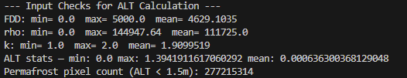
PERMAFROST MAPPING
Observation:
Most terrain around Leh and Kargil is bright yellow, meaning high permafrost potential.
Manali region shows relatively lower intensity (orange–purple), indicating transitional or patchy permafrost.
Parameter | Explanation | Meaning
FDD | Freeze Degree Days | Min = 0.0, Max = 5000.0, Mean = 4629.1 → shows the total freezing thermal load over the year. A high mean suggests long and cold winters, suitable for permafrost formation.
rho | Soil density (kg/m³) | Mean = 111725 → This seems 100x higher than typical (~1300–1600 kg/m³), likely because bulk_density was already in kg/m³ but was multiplied again. This high density artificially reduces ALT thickness.
k | Thermal conductivity (W/mK) | Range is realistic: 1.0–2.0 W/mK → indicates moderate to high conductivity depending on soil type.
ALT stats | Active Layer Thickness (m) | Max = 1.39 m, Mean = 0.0006 m → The extremely low mean means most regions are predicted to be near-frozen year-round, i.e., likely permafrost.
Permafrost pixel count | Number of pixels where ALT < 1.5 m | 277,215,314 → Almost all pixels in your study area are considered permafrost under this condition.

Slide 12
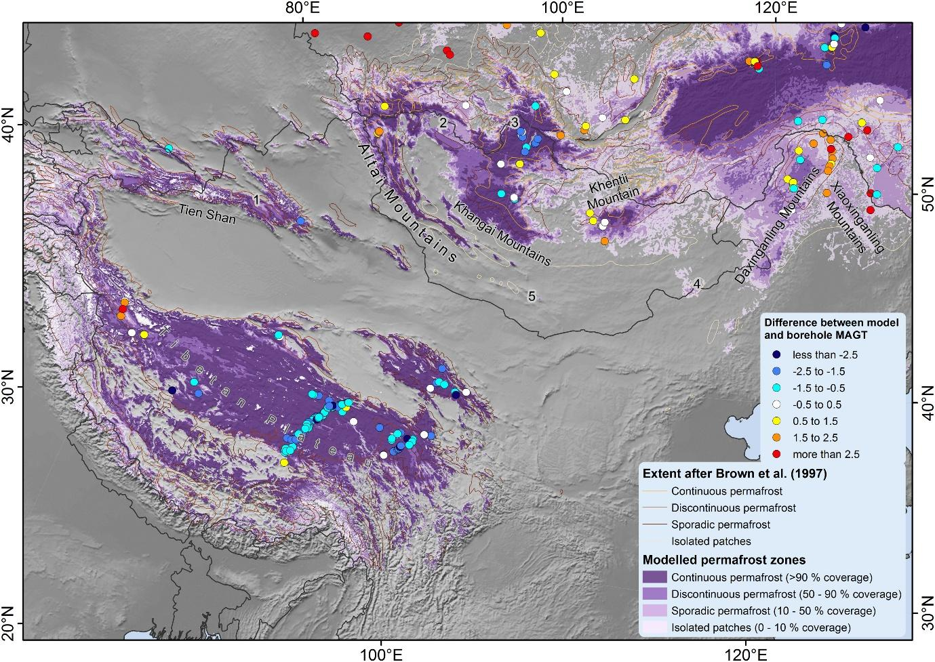
PERMAFROST MAPPING
Ground Truth
Output

Slide 13
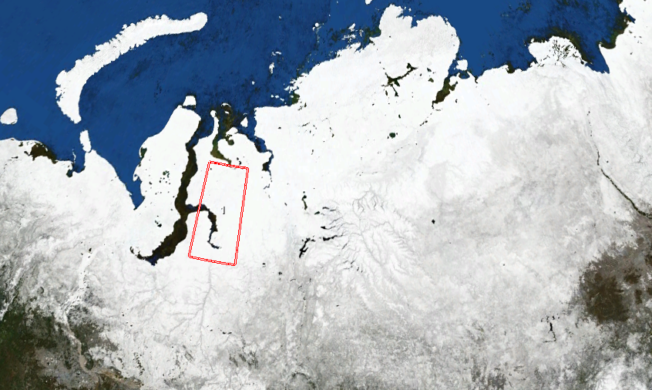
PERMAFROST MAPPING
Region of Interest & Time Period (RUSSIA):
Coordinates: 75.5°E to 80.5°E, 67.0°N to 71.0°N
Key Locations in India: Salekhard, Labytnangi, Nadym, Novy Urengoy, Noyabrsk, Tazovsky, Antipayuta, Gyda, Yamburg, Sabetta
Time Period: January 2020 to December 2023

Slide 14
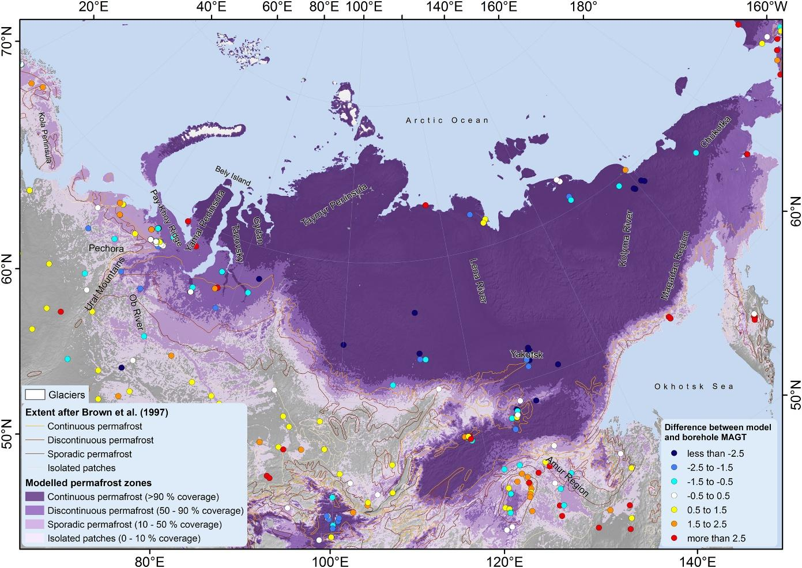
PERMAFROST MAPPING
Ground Truth

Slide 15
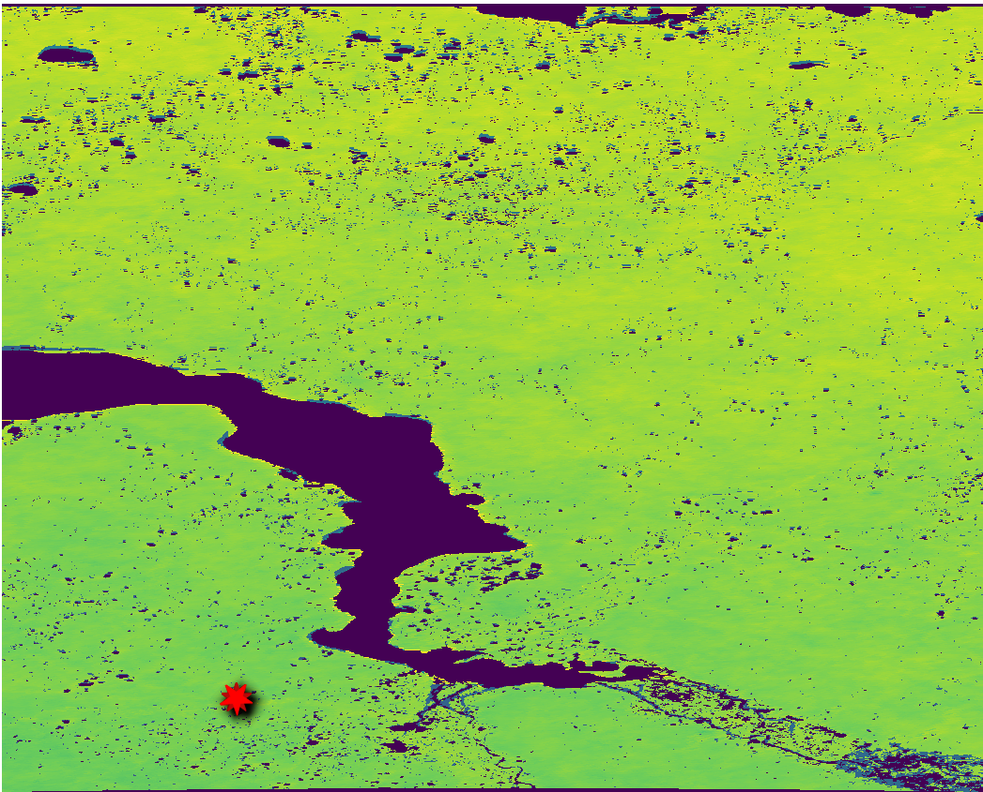
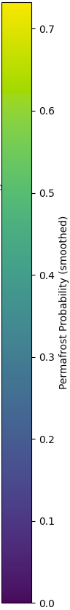

PERMAFROST MAPPING
Output:
--- Input Checks for ALT Calculation ---
FDD: min= 0.0 max= 5000.0 mean= 4556.725
rho: min= 0.0 max= 139894.02 mean= 105376.97
k: min= 1.0 max= 2.0 mean= 1.8855983
ALT stats — min: 0.0 max: 2.54236106189146 mean: 0.0006644549458326142
Permafrost pixel count (ALT < 1.5m): 276547365
Borehole Data Available

Slide 16
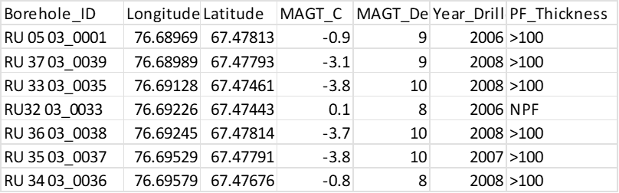
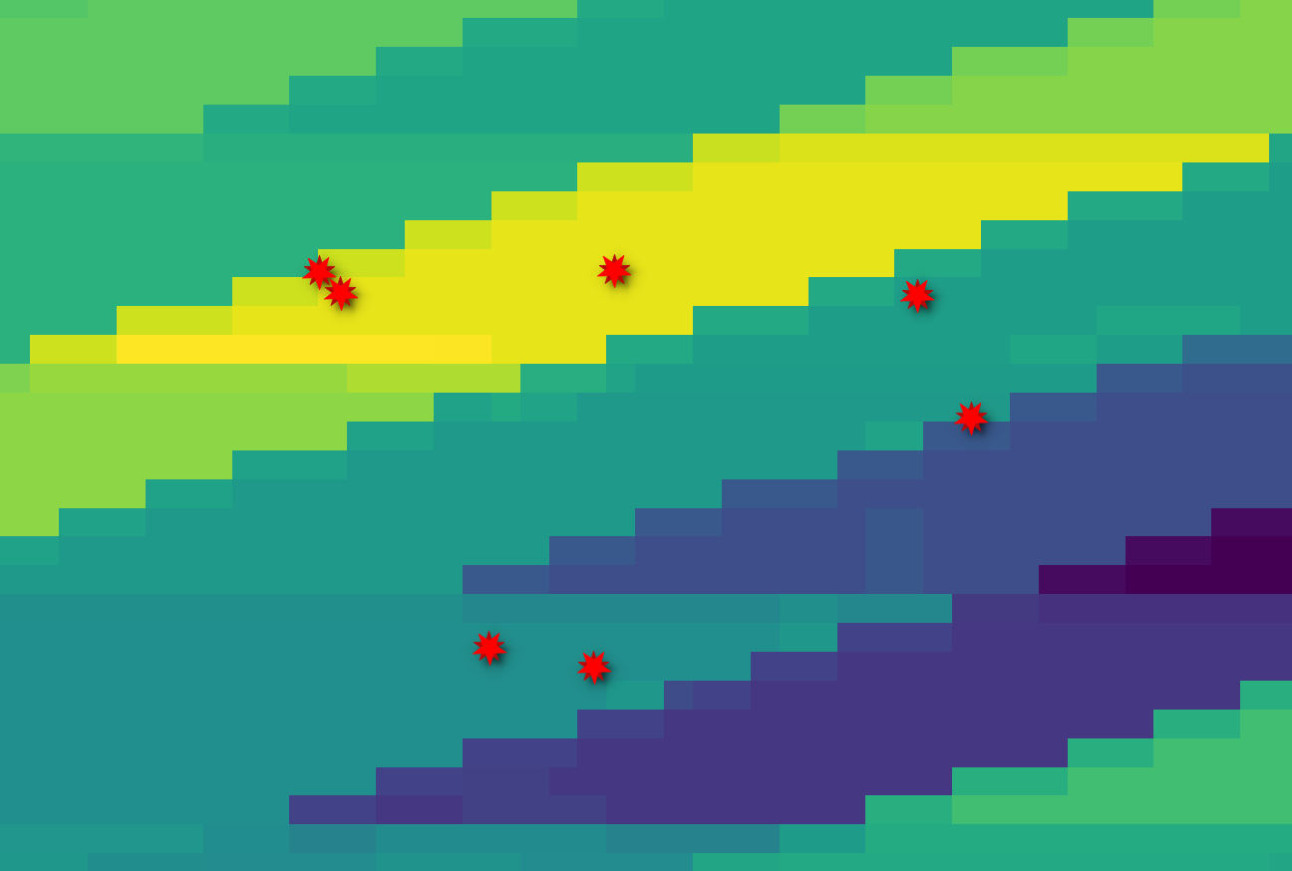

Slide 17
Terrain-Constrained A* Path Planning for Off-Road Autonomous Navigation
A Case Study using DEM and Slope Data

Slide 18
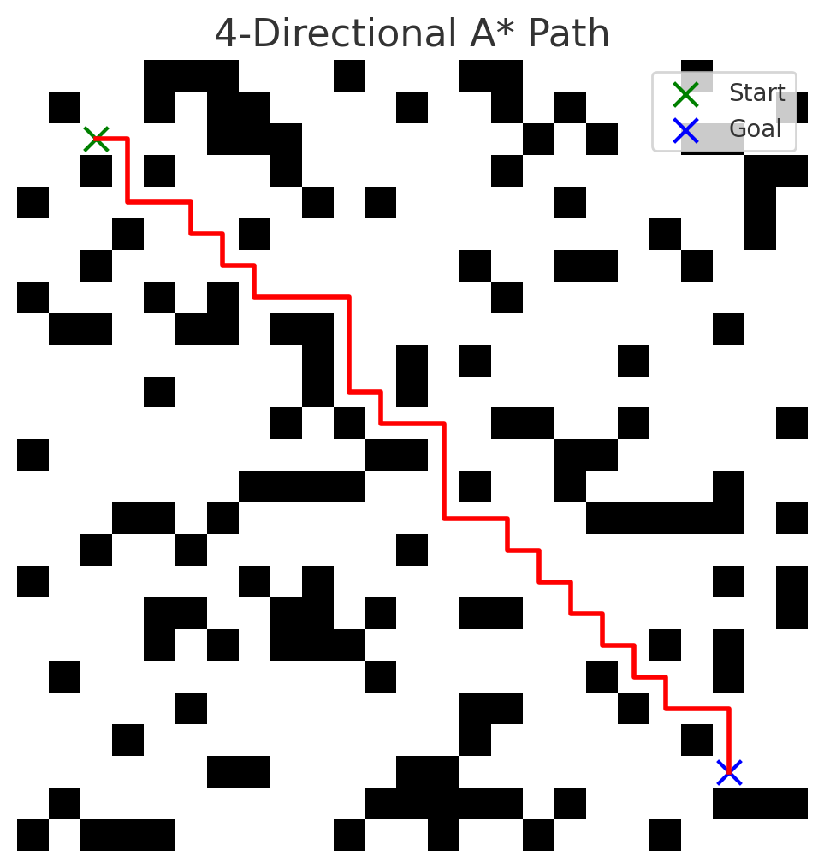
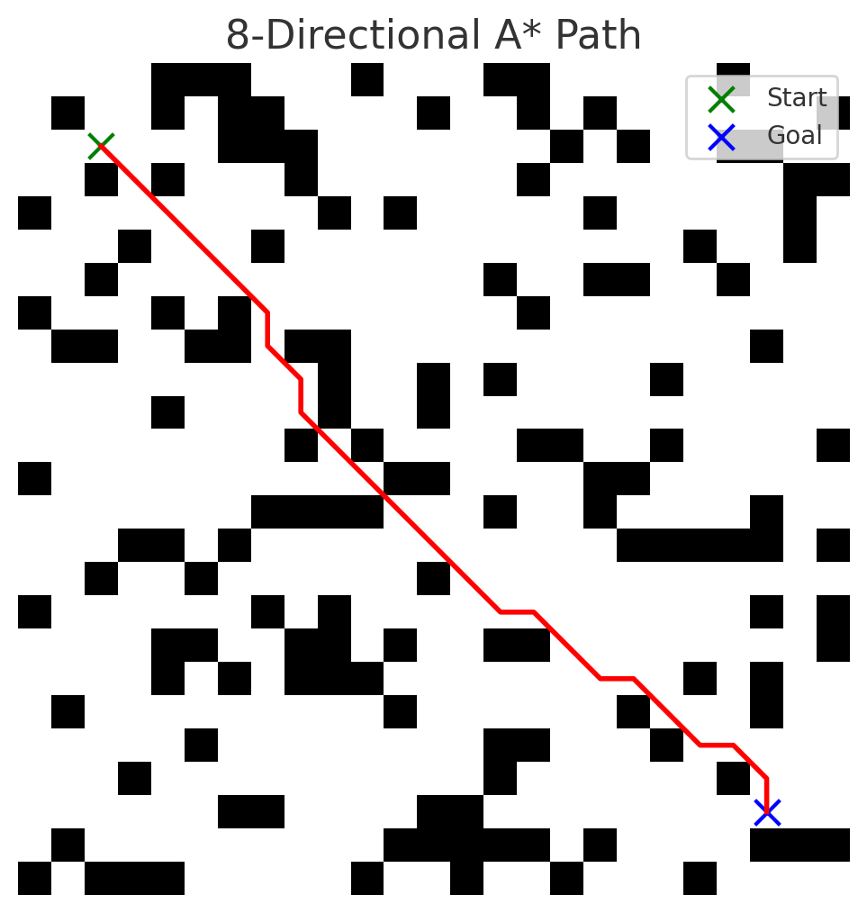
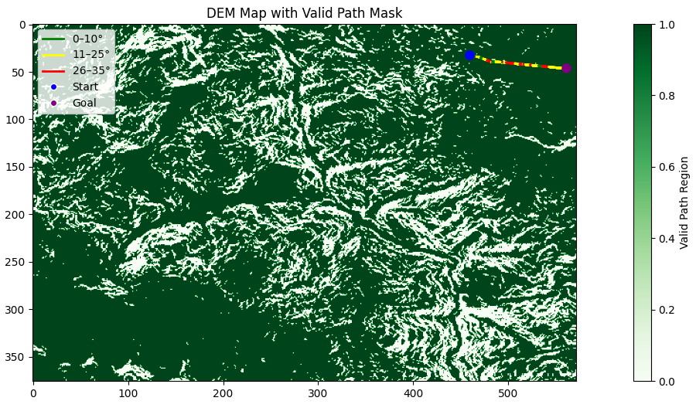
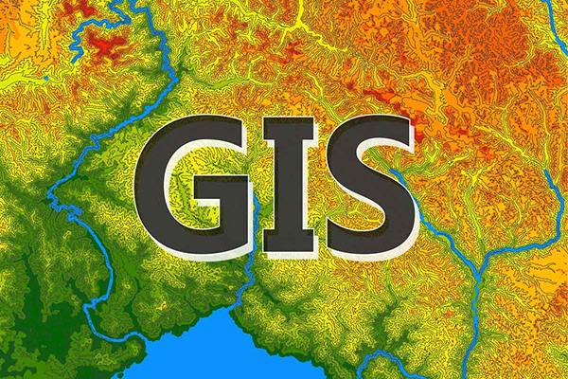
INTRODUCTION
Autonomous path planning is vital for off-road and unstructured environments, especially in domains where conventional road infrastructure is absent.
Critical Real-World Applications:
Military Logistics in high-altitude border zones
Disaster Relief in landslide-affected mountainous regions
Scientific Exploration in glacial or rugged terrain
These missions demand terrain-adaptive algorithms that ensure feasibility, safety, and tactical efficiency.
Key Challenge with Classical A*
Assumes uniform traversability — does not account for slope, terrain type, or elevation gain.
Fails to identify unsafe paths — may route across steep cliffs or unstable surfaces.
Discrete Grid Limitation:
Terrain is interpreted as a regular pixel grid.
This causes zig-zag artifacts and inflexible movement, especially in diagonal navigation.
Results in non-smooth paths unfit for heavy or tracked vehicles.

Slide 19
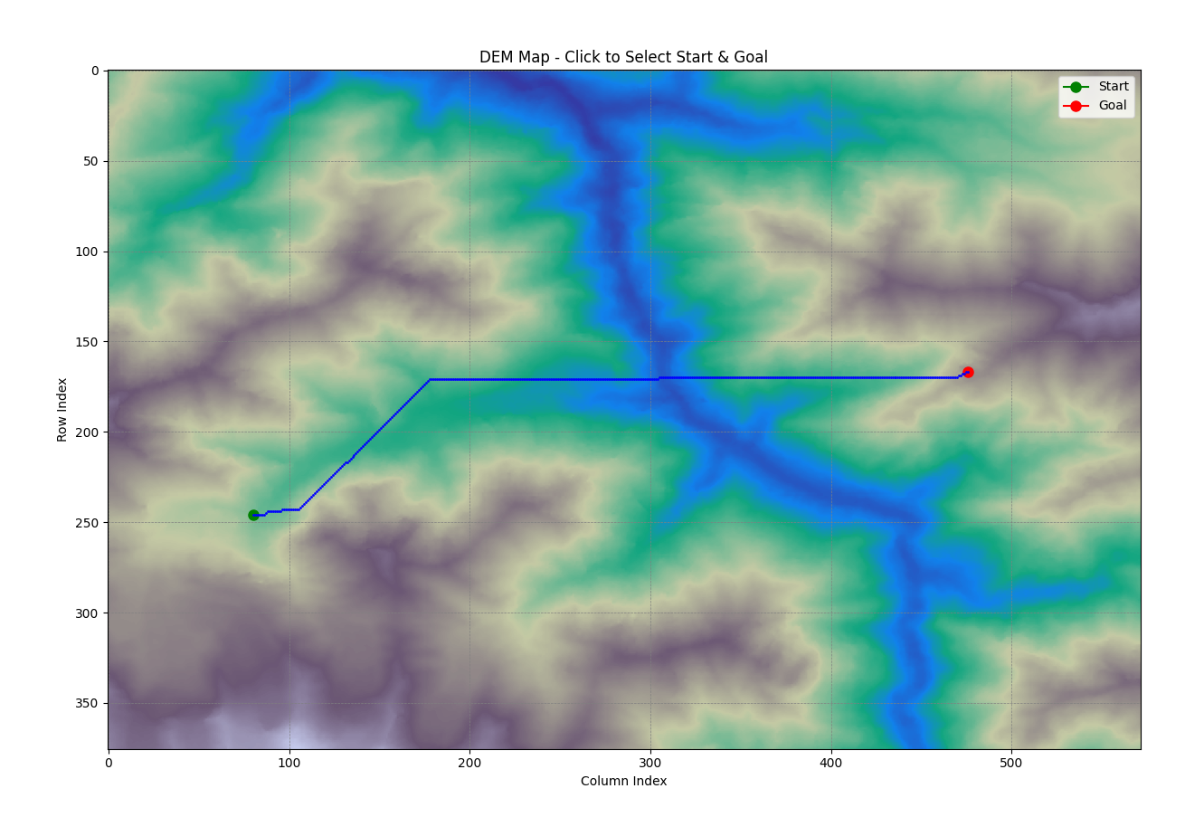
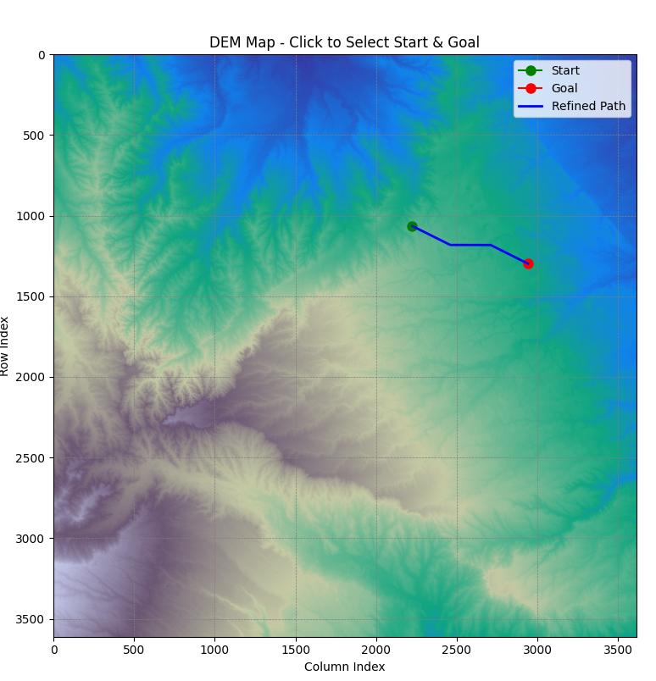
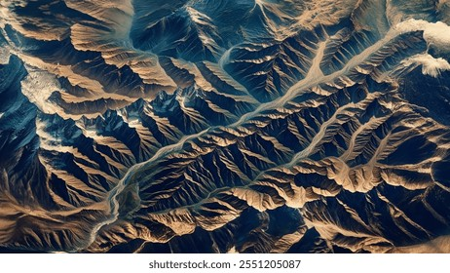
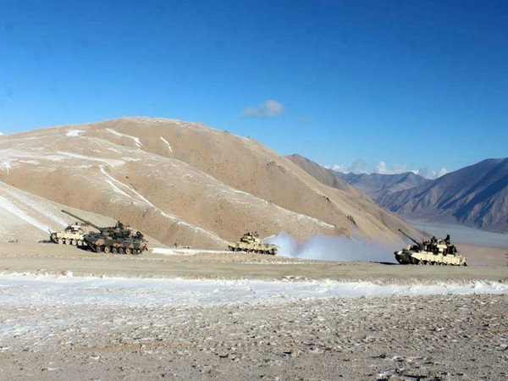
BACKGROUND
Terrain-aware navigation is essential in off-road environments where no fixed roads, dynamic terrains, and high slope variability exist.
Digital Elevation Models (DEM) and slope rasters are fundamental data sources:
DEM provides height information across a landscape.
Slope layers derived from DEM indicate terrain steepness.
Classical A* algorithm limitations:
Assumes flat, uniform traversal cost.
Ignores slope, elevation, and physical feasibility.
Generates zigzag paths that are impractical for heavy tracked vehicles like tanks.
Terrain-induced risks like rollovers, path blockage, or inaccessibility demand integration of topographical constraints into planning.

Slide 20
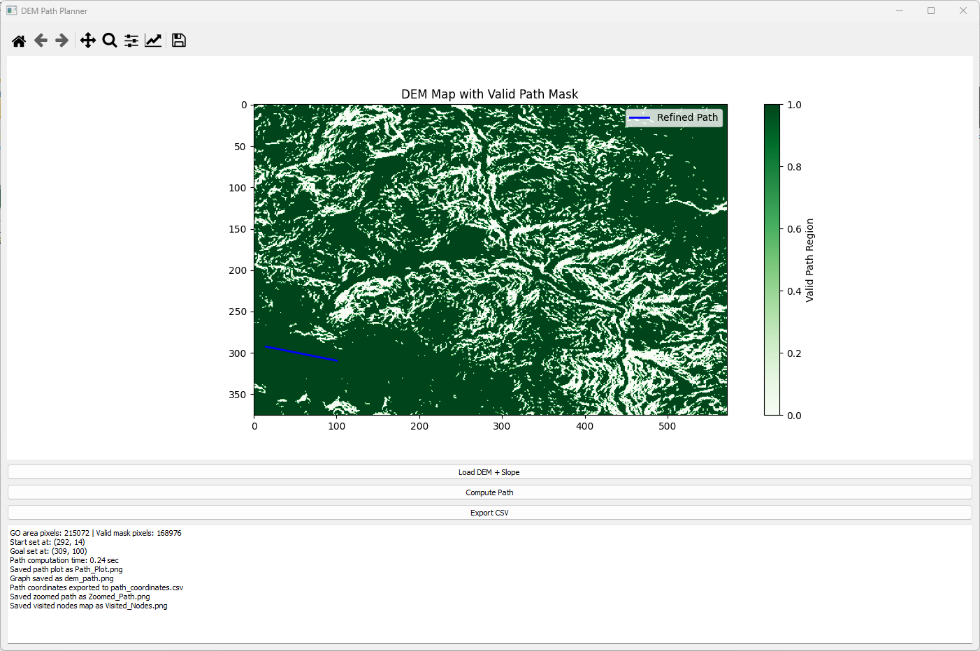
MOTIVATION
Operational Need
Autonomous navigation in military missions, emergency response, and disaster logistics demands safe, realistic, and terrain-compliant routes.
Example: Heavy tanker deployment in mountainous or remote warzones where roads are damaged or absent.
Limitations of Road-Based Systems
Existing GPS-based or map-based path planners fail in off-road scenarios due to lack of slope awareness and terrain classification.
Real-World Navigation Gaps
High-resolution DEMs and slope maps are underutilized in real-time A* planning.
Traditional A* planners cannot ensure path stability for tracked/tank vehicles operating under harsh terrain conditions.
Goal of This Work
Develop an enhanced A* algorithm that:
Considers terrain slope and elevation.
Generates paths safe for large, heavy ground vehicles like defense tankers.
Enables semi-realistic simulation of no-road operations using publicly available geospatial data.

Slide 21
Literature Review
Method | Terrain Data Used | Pros | Cons | Reference
Classical A* | None | ⚡ Simple & fast📦 Widely used in structured domains | ⚠️ Ignores terrain characteristics🧭 Unsafe in steep/rough zones | N/A (Baseline method)
Terrain-Aware A* | DEM, Slope | ✅ Terrain-compliant🧗 Slope-aware routing🚜 Safer for tracked vehicles | 🕒 Higher compute cost🗺 Requires preprocessing (e.g., slope mask) | [Khan et al., 2021]
PRM + A* | DEM, Slope | ⏱ Efficient preplanning🧭 Flexibility in search space | 📋 Needs prior obstacle mask🧱 Might avoid narrow passable zones | [Karaman & Frazzoli, 2011]
Subpixel A* | DEM | 🎯 Smooth & realistic paths↘ Fine directional resolution | 🧠 Increased memory usage🐢 Slower planning time | [Nash & Koenig, 2012]
Hybrid A* | DEM | 🚗 Kinematics-aware paths📉 Reduced sharp turns | 🧩 Complex integration📉 Inefficient over large terrain datasets | [Dolgov et al., 2008]

Slide 22
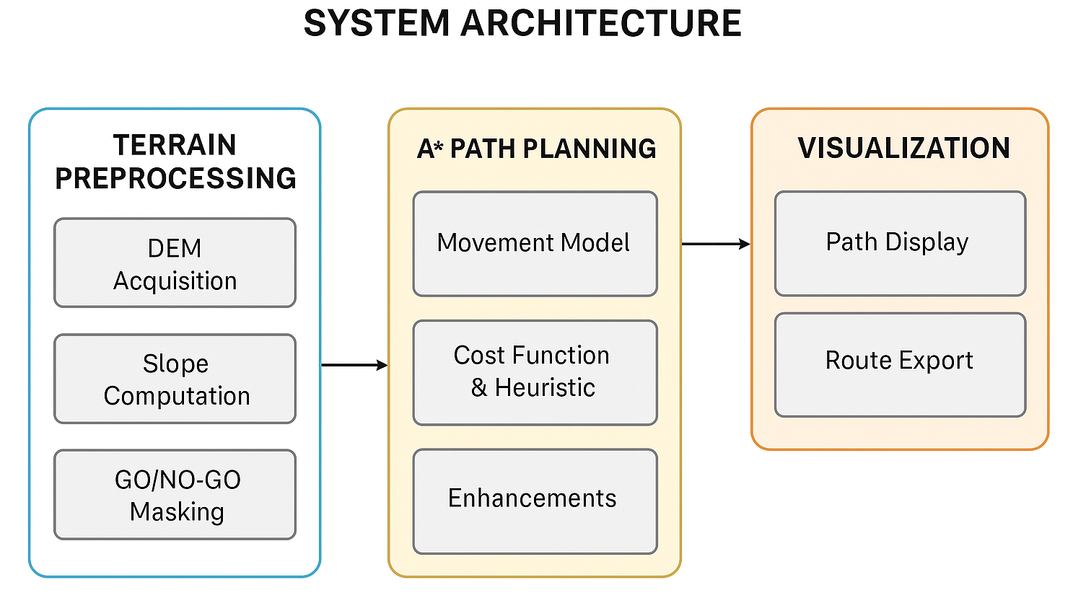
System Architecture and Design
Modular System Workflow
Terrain Data Input
Load preprocessed DEM (Elevation) and Slope GeoTIFFs.
Apply GO/NO-GO filtering based on elevation/slope thresholds.
Preprocessing Module
Generate valid traversal masks from slope data (≤35° constraint).
Optional: Morphological dilation to expand safe navigation zones.
3.Core A* Planner
Implements:
8-directional or 32-directional search
Subpixel resolution
Slope-aware cost modification
Uses Euclidean distance heuristic with elevation and slope penalties.

Slide 23
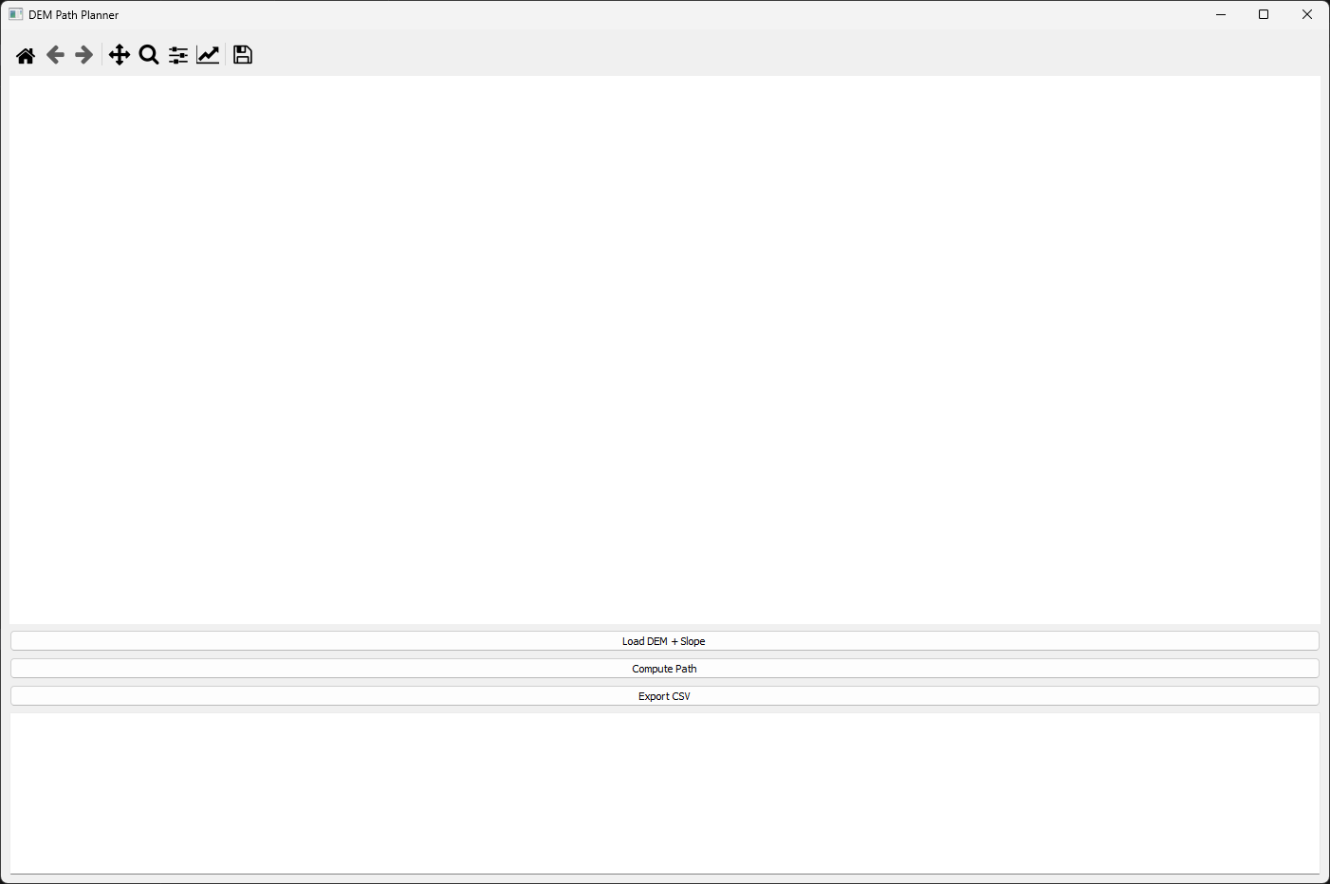
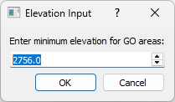
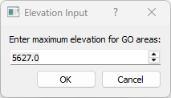
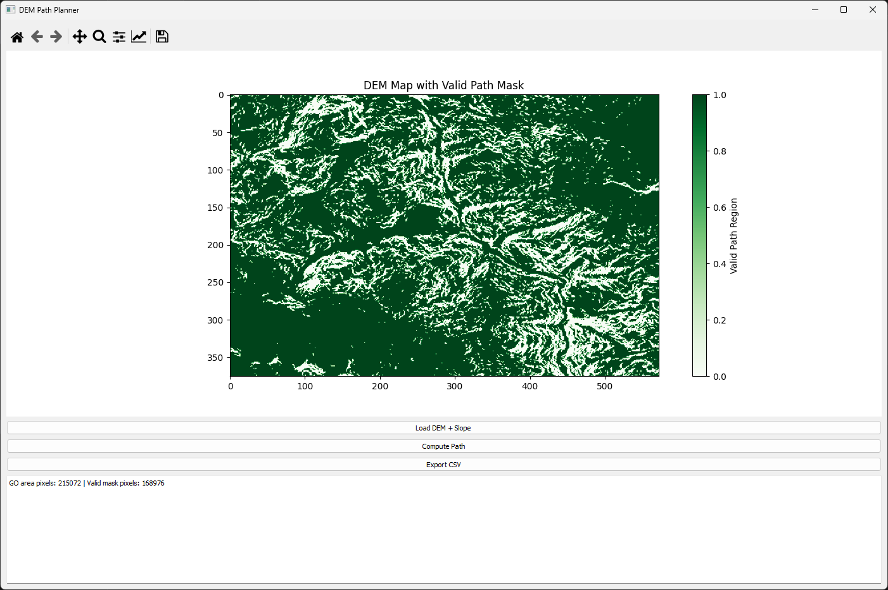
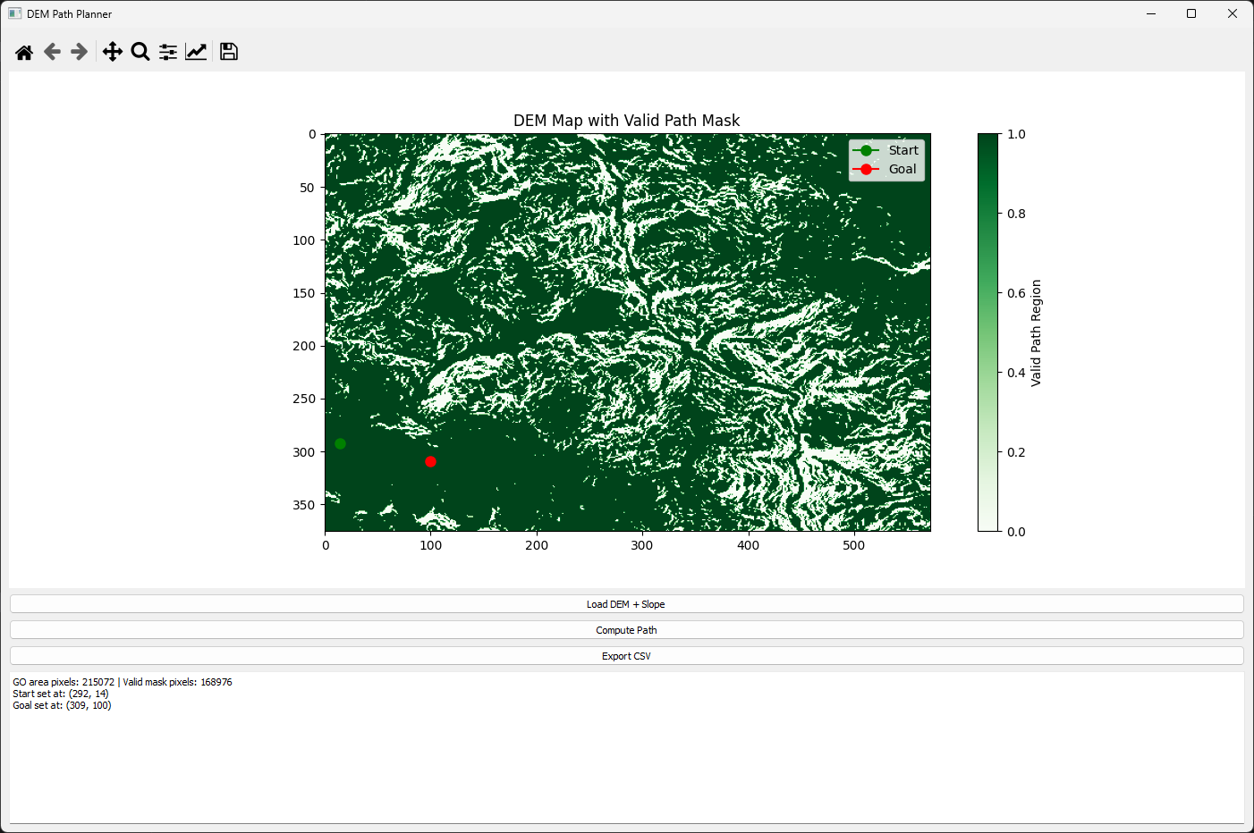
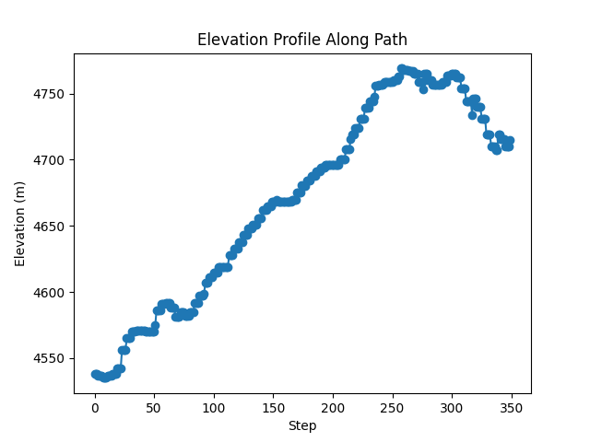
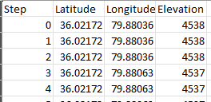
Implementation
DEM-Based Path Planning GUI Using Elevation and Slope-Constrained Subpixel A* Search
Tools and Technologies
Programming Language: Python 3.11
GUI Framework: PyQt5
Raster Processing: Rasterio, NumPy, GDAL
Visualization: Matplotlib, Pandas
Environment: VS Code on Windows 11
def a_star_subpixel(self, substeps=4, angular_resolution=32):
start = (self.start[0] + 0.5, self.start[1] + 0.5)
goal = (self.goal[0] + 0.5, self.goal[1] + 0.5)
open_set = [(0, start)]
came_from = {}
g_score = {self._quantize(start): 0}
directions = [(np.cos(θ), np.sin(θ))
for θ in np.linspace(0, 2*np.pi, angular_resolution, endpoint=False)]
while open_set:
_, current = heapq.heappop(open_set)
if heuristic(current, goal) < (2.0 / substeps):
return self.reconstruct_path(came_from, current)
for dx, dy in directions:
neighbor = (current[0] + dx/substeps, current[1] + dy/substeps)
r, c = int(neighbor[0]), int(neighbor[1])
if self.valid_mask[r, c] and self.slope_data[r, c] <= 35:
g = g_score[self._quantize(current)] + np.hypot(dx, dy)/substeps
if neighbor not in g_score or g < g_score[neighbor]:
came_from[neighbor] = current
g_score[neighbor] = g
f = g + heuristic(neighbor, goal)
heapq.heappush(open_set, (f, neighbor))
Step 1- Load Raster Data
Step 2-Define Elevation Range
Terrain Data Processing
Input: 30 m resolution SRTM DEM and slope rasters (GeoTIFF)
Preprocessing:
Load rasters
Apply valid GO/NO-GO mask based on slope
Overlay filters for elevation range
Step 3-Visualize Valid Terrain
Step 4-A* Path Planning Execution
A* Algorithm Details
Resolution: Subpixel-aware (e.g., 0.25 pixel steps)
Direction Model: 32-directional expansion
Heuristics:
Euclidean distance
Modified with slope penalties
Constraint Filters:
Real-time slope masking (>35° blocked)
Elevation constraints
Path Output:
Coordinates, elevation, slope → CSV with metadata
Output
path_coordinates.csv
Elevation along the planned path
Planned Path

Slide 24
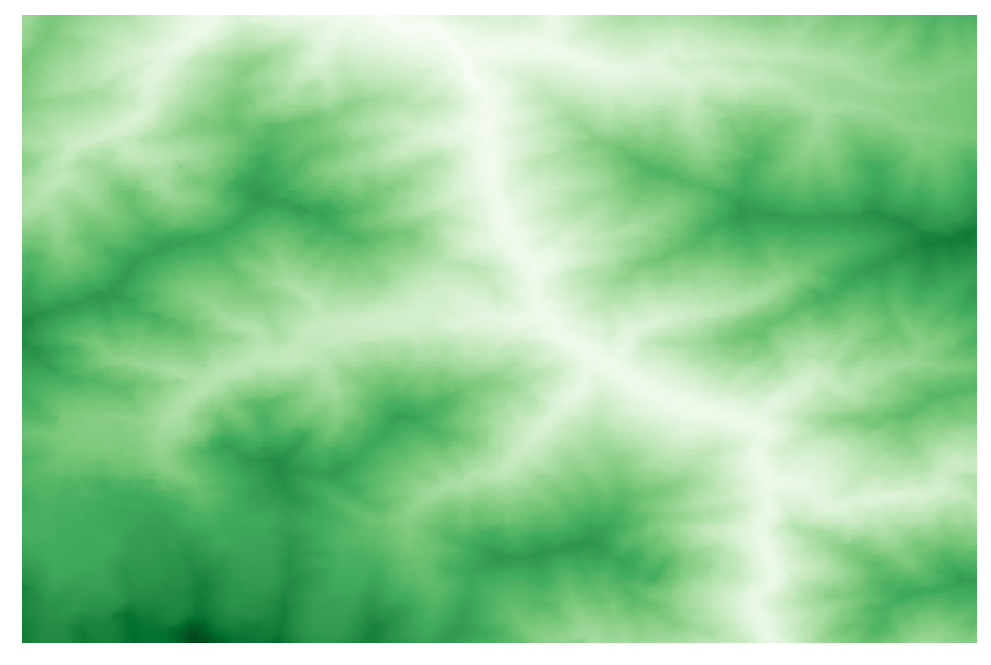
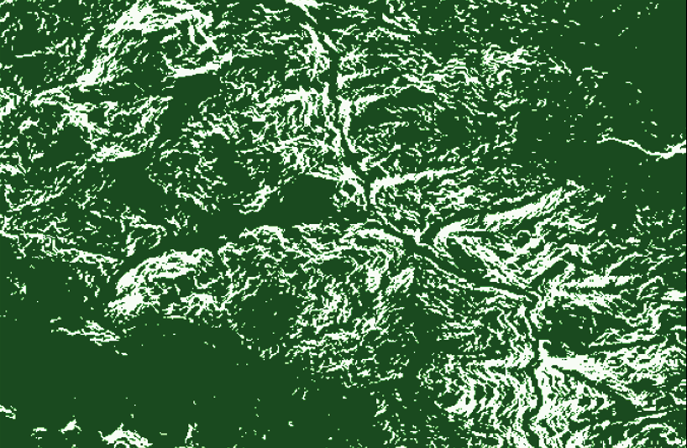
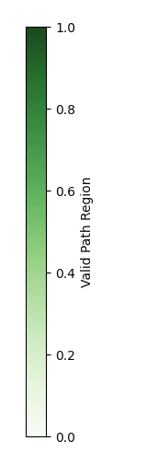
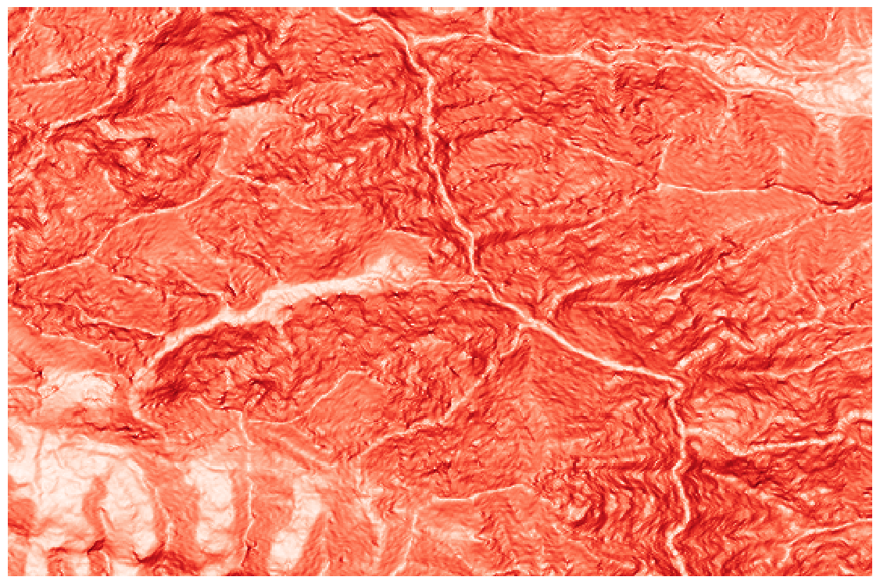
Implemantation
DEM-Based Path Planning GUI Using Elevation and Slope-Constrained Subpixel A* Search
Cost Map Generation
1. Data Inputs
DEM and Slope Raster Input: The GUI accepts two GeoTIFF inputs:
1. DEM: Elevation data
GO Area and Valid Mask: Based on user-defined elevation bounds [min,max][min, max][min,max], two binary masks are created:
self.go_area = (self.dem_data >= self.min_elev) & (self.dem_data <= self.max_elev)
self.valid_mask = self.go_area & (self.slope_data <= 35)
2.Slope Raster: Precomputed terrain slope
Pixels outside the elevation range or with slope > 45° are marked invalid. Final mask valid_mask is used for path expansion (1.0 = valid, 0.0 = blocked).
Green to dark green (1.0) = Navigable White (0.0) = Non-navigable

Slide 25
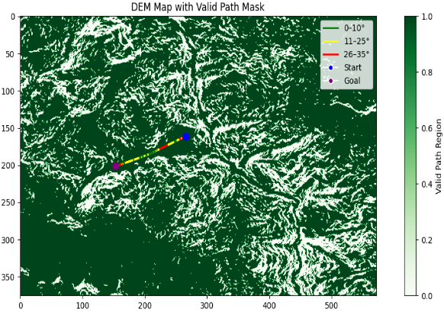
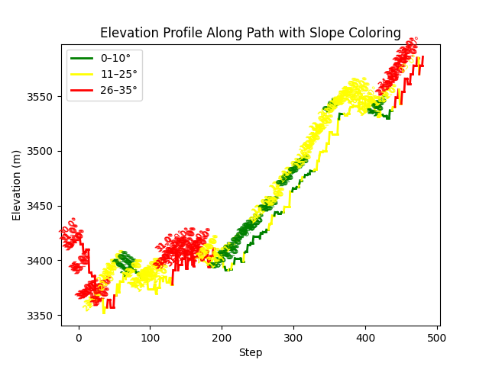
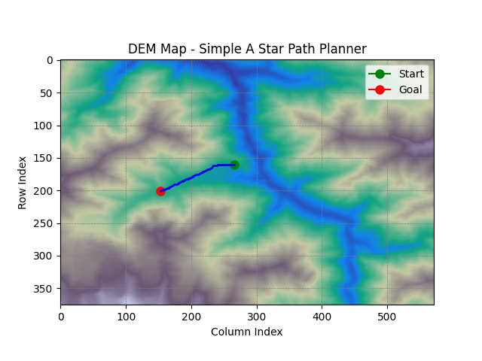
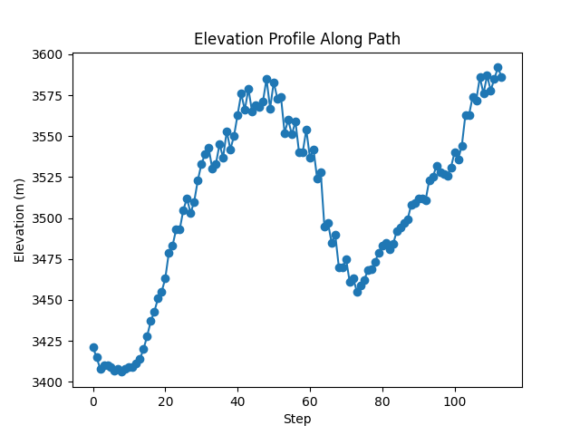
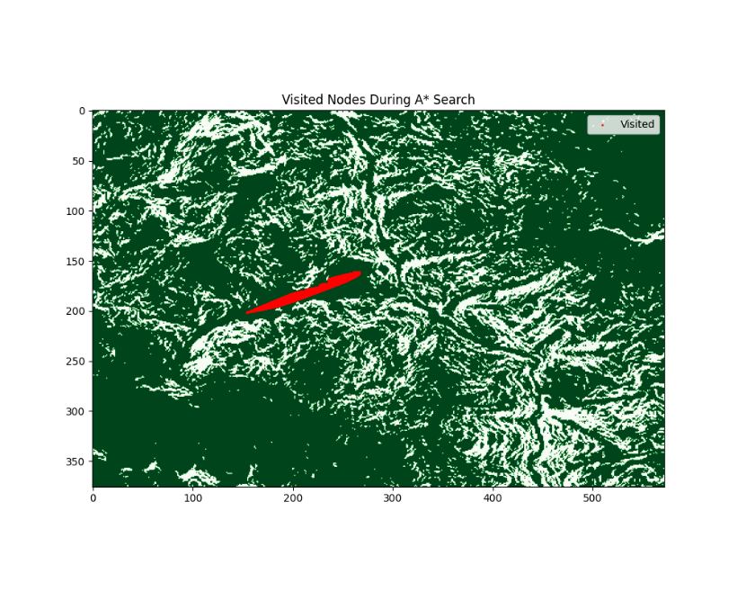
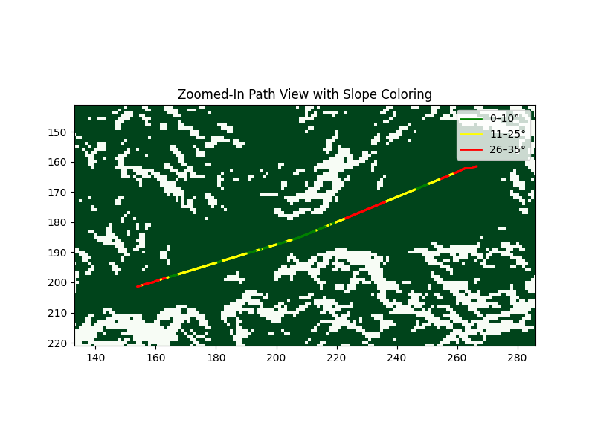
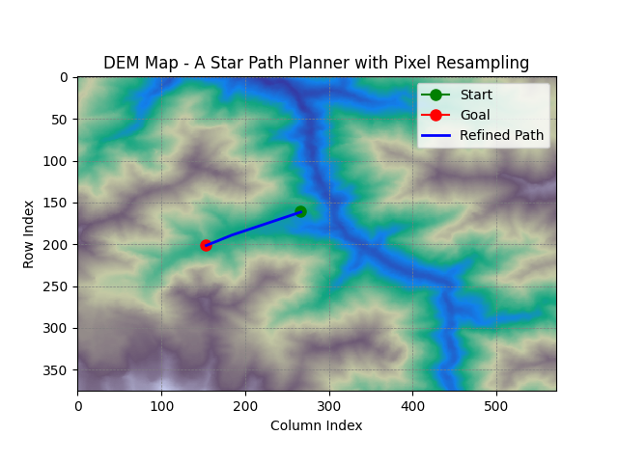
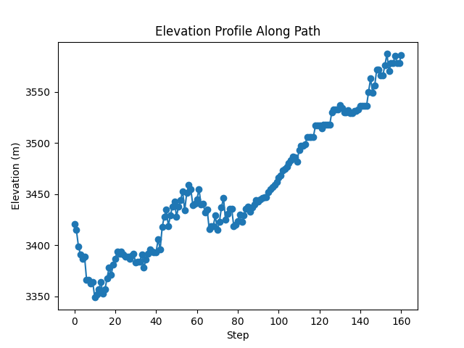
Results
Test 1 Output Start set at: (161, 266) Goal set at: (201, 153)
A Star with Pixel Resampling with Constraints
Simple A Star
A Star with Pixel Resampling
Variant | Computation Time (s) | Path Length (m) | Elevation Gain (m) | Average Slope (°) | Max Slope (°) | Slope Violations (>35°) | Slope Compliance (%)
Simple Astar | 0.08 | 3309.97 | 491 | 22.61 | 58 | 48 | 57.89
Resampling Astar | 0.91 | 3811.08 | 542 | 20.38 | 43 | 17 | 89.44
Slope_filter | 950.86 | 3732.81 | 483 | 18.29 | 35 | 0 | 100

Slide 26
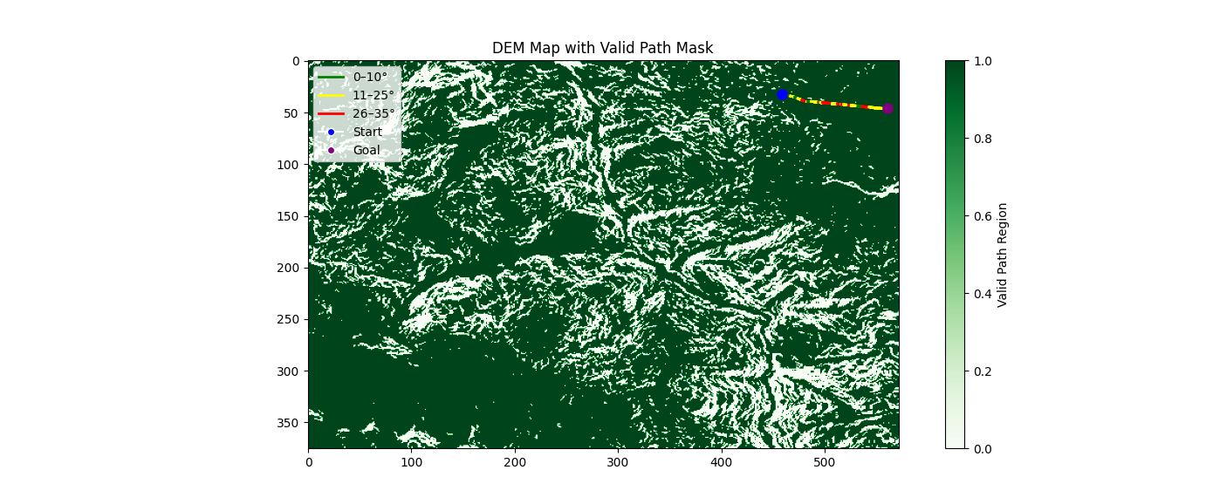
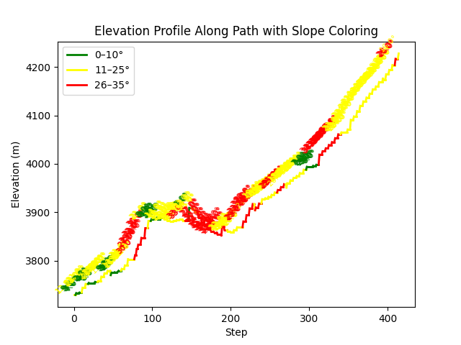
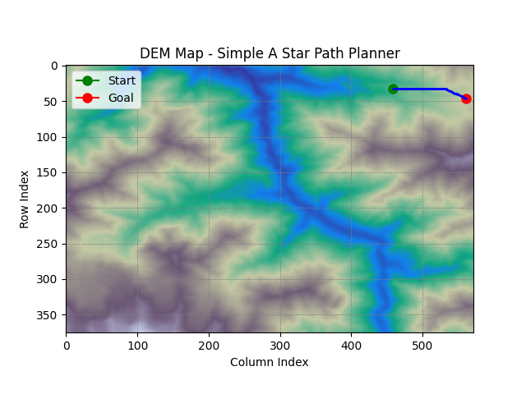





Results
Test 2 Output Start set at: (32, 459) Goal set at: (46, 561)
A Star with Pixel Resampling with Constraints
Simple A Star
A Star with Pixel Resampling
Variant | Computation Time (s) | Path Length (m) | Elevation Gain (m) | Average Slope (Â°) | Max Slope (Â°) | Slope Violations (>35Â°) | Slope Compliance (%)
Simple Astar | 0.03 | 2670.33 | 656 | 21.7 | 42 | 16 | 84.47
Resampling Astar | 1.85 | 2670.37 | 605 | 21.14 | 47 | 13 | 87.38
Slope_filter | 881.88 | 2779.96 | 613 | 20.01 | 35 | 0 | 100

Slide 27








Results
Test 3 Output Start set at: (72,163) Goal set at: (167,120)
A Star with Pixel Resampling with Constraints
Simple A Star
A Star with Pixel Resampling
Variant | Computation Time (s) | Path Length (m) | Elevation Gain (m) | Average Slope (°) | Max Slope (°) | Slope Violations (>35°) | Slope Compliance (%)
Simple Astar | 0.07 | 3215.14 | 586 | 27.51 | 58 | 41 | 57.29
Resampling Astar | 0.95 | 3481.31 | 708 | 29.23 | 55 | 61 | 57.93
Slope_filter | 2901.24 | 3981.39 | 631 | 27.96 | 35 | 0 | 100

Slide 28








Results
Test 4 Output Start set at: (301,23) Goal set at: (306,126)
A Star with Pixel Resampling with Constraints
Simple A Star
A Star with Pixel Resampling
Variant | Computation Time (s) | Path Length (m) | Elevation Gain (m) | Average Slope (°) | Max Slope (°) | Slope Violations (>35°) | Slope Compliance (%)
Simple Astar | 0.02 | 2567.98 | 286 | 14.4 | 40 | 4 | 96.15
Resampling Astar | 1.25 | 2567.98 | 291 | 15.21 | 40 | 5 | 95.19
Slope_filter | 613.02 | 2614.97 | 285 | 16.31 | 34 | 0 | 100

Slide 29








Results
Test 5 Output Start set at: (271,21) Goal set at: (340,41)
A Star with Pixel Resampling with Constraints
Simple A Star
A Star with Pixel Resampling
Variant | Computation Time (s) | Path Length (m) | Elevation Gain (m) | Average Slope (°) | Max Slope (°) | Slope Violations (>35°) | Slope Compliance (%)
Simple Astar | 0.03 | 2239.2 | 432 | 13.51 | 36 | 1 | 98.57
Resampling Astar | 0.28 | 2317.5 | 436 | 11.49 | 38 | 3 | 96.3
Slope_filter | 335.63 | 2522.6 | 438 | 12.74 | 35 | 0 | 100

Slide 30
Conclusion & Future Work
Conclusion
Developed a terrain-constrained A* path planner tailored for off-road navigation.
Integrated slope and elevation constraints from DEM data to produce safe, slope-compliant paths.
GUI-based tool enables real-time visualization, analysis, and CSV export for mission planning.
Among all variants, Terrain-Constrained A* showed maximum safety, even in high-altitude, no-road zones, making it suitable for tracked defense vehicles like tankers.
Future Work
Real-Time Optimization: Implement GPU-accelerated or C++ backends for faster execution.
Multi-Layer Integration:
Add soil data and bulk density to assess terrain load-bearing capacity — critical for heavy vehicles like tanks.
Integrate hydrological layers to detect rivers/lakes; assess navigability or exclusion zones.
Autonomous Integration:
Add modules for SLAM, or drone-based terrain mapping.
Connect to ROS-based systems for full autonomy pipeline.
Adaptive Planning:
Extend to dynamic replanning under changing terrain or real-time sensor inputs.

